Slide 1
CARTaGENE, GWAS and Fracture events
GWAS or gene-candidate analysis, that’s the question!!
Bastien CHASSAGNOL | Lecturer & Professional Researcher Laval University
Marie Pier Scot-Boyer
source code available on GitHub

Slide 2
Introduction
CartaGene project:
30,000 samples (19,131 included in the study when focusing on Eurasian)
Mostly SNPs (a bit of InDels)
Most WES (and so, not WFS)
6 arrays, 2 reference genomes aligned
Mostly imputed -> From Évaluation de l’imputation des données génétiques Canadiennes-Françaises, from Pelletier (2022): https://umontreal.scholaris.ca/bitstreams/83d64aa1-da20-4a6f-8ae0-9dcb0165417d/download, consider MAF > 0.01

Slide 3
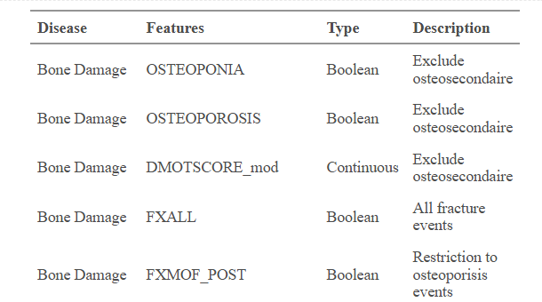
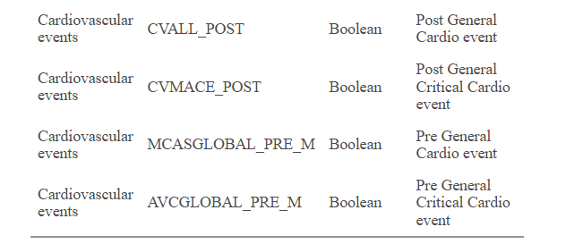
Objectives
Genes tested: HDAC-9, (HDAC4, HDAC10, HDAC7, HDAC-5, HDAC-6, on the X chromosome)…
(side note: HLA complex to study, see Page 83/99: Strong polymorphism, from from Pelletier (2022): https://umontreal.scholaris.ca/bitstreams/83d64aa1-da20-4a6f-8ae0-9dcb0165417d/download ),
Phenotype variables:
Two conditions tested (can be considered independently): cardiovascular and bone disease events
9 binary variables: Control encoded by a 1, Case by a 2
One continuous, z-scaled score: DMOTSCORE_mod (which pre-processing has been performed?)
Additional genotype/population level variables included in the model via PCA loadings
Which encoding used for GENDER01? -> add mapping and description of phenotype table.

Slide 4
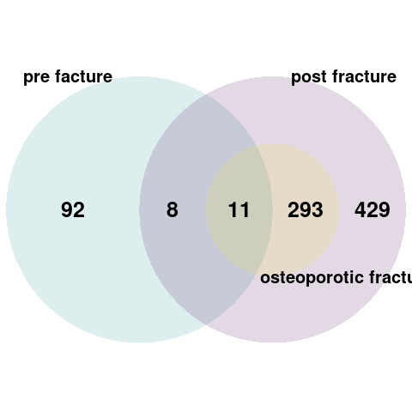
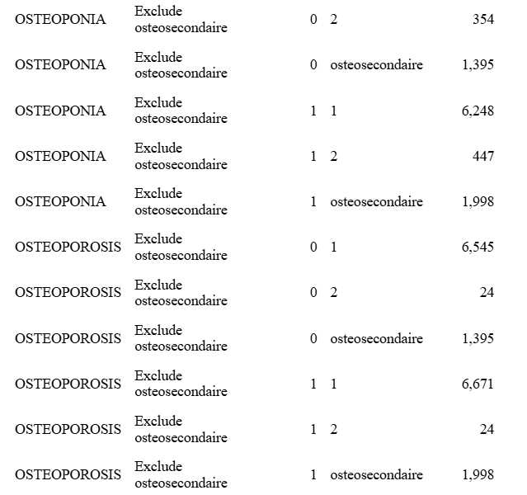
Phenotype focus: bone damage
Careful with adding missing values when osteosecondaire==1!! (risk of confusing truly missing from discarded samples for clinical reasons!!) + loss of strong power when discarding samples as such!!)
OSTEOPONIA is case: 1 if DMOTSCORE_mod <= -1.5
OSTEOPOROSIS is case: 1 if DMOTSCORE_mod < -2.5
FXALL = FXALL_PRE5 (or FXALL_PRE1 ??) union FXALL_POST

Slide 5
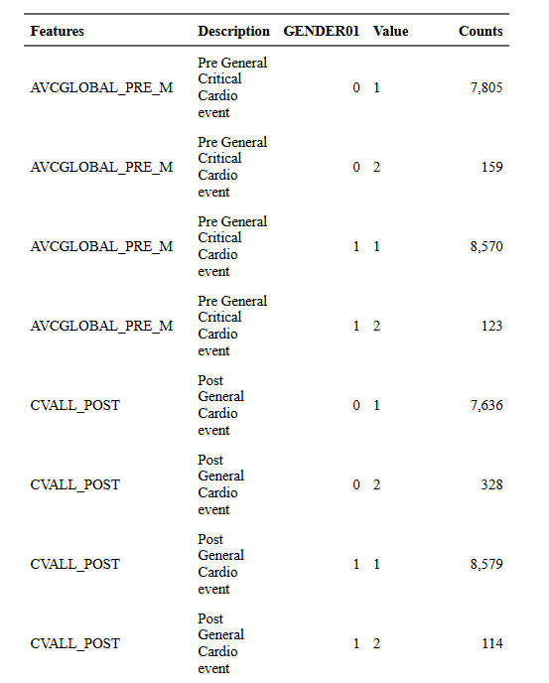
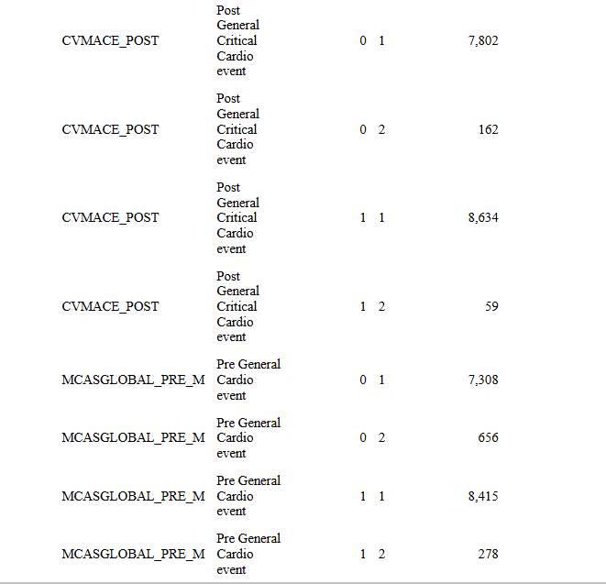
Phenotype focus: cardiovascular event
AVCGLOBAL_PRE_M
CVALL_POST
CVMACE_POST (the most critical cardio events) and MCASGLOBAL_PRE_M (why seeting apart pre- vs post- diagnostic events)

Slide 6
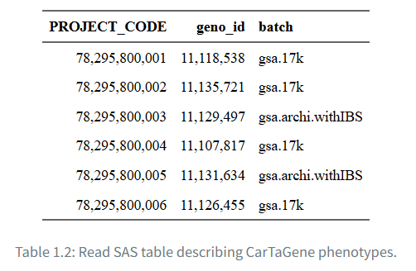
Methods: PCA Computation, step 1)
Merge the 6 genotype arrays (two genome assemblies!!)
Restriction on white, Causasian individuals
BIM/BED/FAM/hh files stored in /mnt/projects_tn01/Cartagene/analyses/QC
Filter out strongly correlated and bad-quality SNPs, based on:
Low Genotyping Rate (< 0.95)
Strong Hardy-Weinberg Disequilibrium (1e 10^-6)
Strong linkage disequilibrium (local regression + prior expert knowledge, in regions such as MHC or Lactase)
Filter out strongly affiliated individuals (IBD)
Run PCA and incorporate the first 10 components

Slide 7
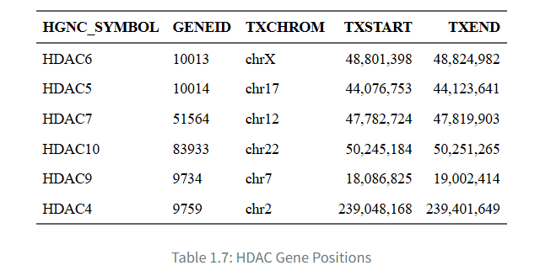
Methods: Model Analysis, step 2)
Gene-candidate approach ->
Extract the regions of interest (coding sequence) with AnnotationDbi + GenomicFeatures::makeTxDbFromUCSC packages
Extract SNPs using script ‘./shell/extract_variants.sh’
Remove variants with MAF (Minor Alle Frequency) below 1%
VCF files before extraction are stored under /mnt/projects_tn01/Cartagene/cartagene-gwas/data/genotypages
VCF files after extraction are stored under /mnt/projects_tn01/Cartagene/cartagene-gwas/data/variants
Under the hood, relies on bcftools view command, instead of previous bcftools filter

Slide 8
Methods: Model Analysis, step 2)
Plink2:
Version: v2.0.0-a.6.9LM 64-bit Intel
GLM model (logistic regression for binary variables, lm for continuous variables)
No mixed linear approach (partly the case with inclusion of PCA covariates, see package genesis for potential extension)
No inclusion so far of strong leveraged phenotypic features, such as sex or age
Additive model assumption
Under the hood, call ./shell/plink2_gwas.sh script, running on all covariates at once
Independence assumption (run per individual)

Slide 9
Side note on Pipeline: reproducibility
GitHub: https://github.com/ArnaudDroitLab/cartagene-gwas
GitHub pages: https://arnauddroitlab.github.io/cartagene-gwas/ (Had to change the visibility)
GH actions: https://github.com/ArnaudDroitLab/cartagene-gwas/tree/master/.github/workflows (re-run the website whenever you push on the main branch)
Folder (internal for now): /mnt/projects_tn01/Cartagene/cartagene-gwas
Centralised repo for problems reporting: https://github.com/ArnaudDroitLab/cartagene-gwas/issuesTools: included within the script, under the /bin folde. To install them from scratch (not useful currently): https://arnauddroitlab.github.io/cartagene-gwas/tools_installation.html
Automated docx and html generation report, using quarto book projects

Slide 10
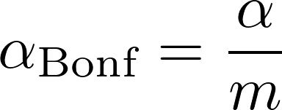
Preliminary results on HDAC-9: Multiple test correction
Bonferroni-corrected threshold
R Formula: 0.05/(num_variants*length(cartagene_response_variables$Features))
Specific to the evaluated gene (dependant on the number of identified SNPs)
Computation of m: the number of independent tests
Number of variants for the considered gene: 2622
Number of phenotype features: 9
From alpha=0.05 to alpha_adj= 2.11^10{-6}
The more you include variables in the design, the more power you lose.
Avoid integrating strongly correlated phenotype features.

Slide 11
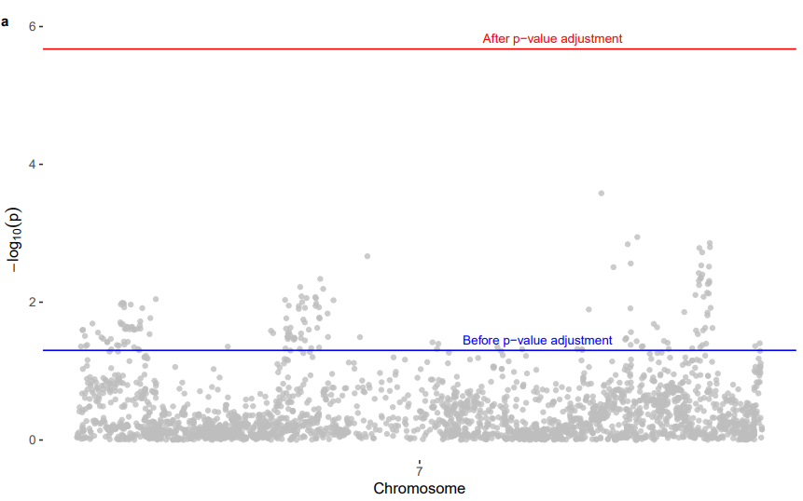
Preliminary results on HDAC-9: GWAS visualisations Example with OSTEOPONIA feature
Manhattan plot
Recommendation from Marie-Pier:
Either full GWAS
Or follow guidelines from (with a historically prior defined threshold): A current guide to candidate gene association studies

Slide 12
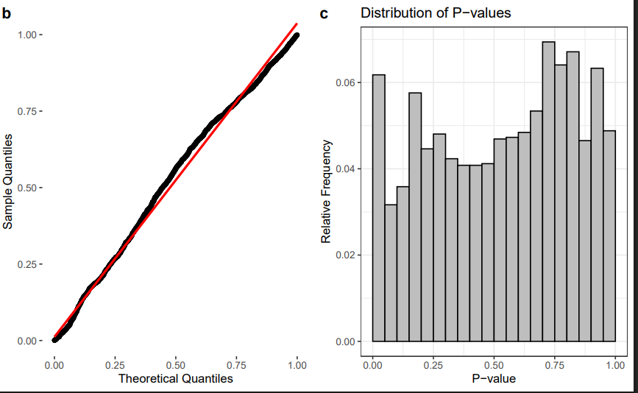
Preliminary results on HDAC-9: GWAS visualisations Example with OSTEOPONIA feature
Histogram
Under H0:
Theoretical distribution (in red) aligns with empirical one (in black)
Boxplots averaging around 0.05 everywhere
QQplot
Recommendation from Marie-Pier:
Either full GWAS
Or follow guidelines from (with a historically prior defined threshold): A current guide to candidate gene association studies

Slide 13
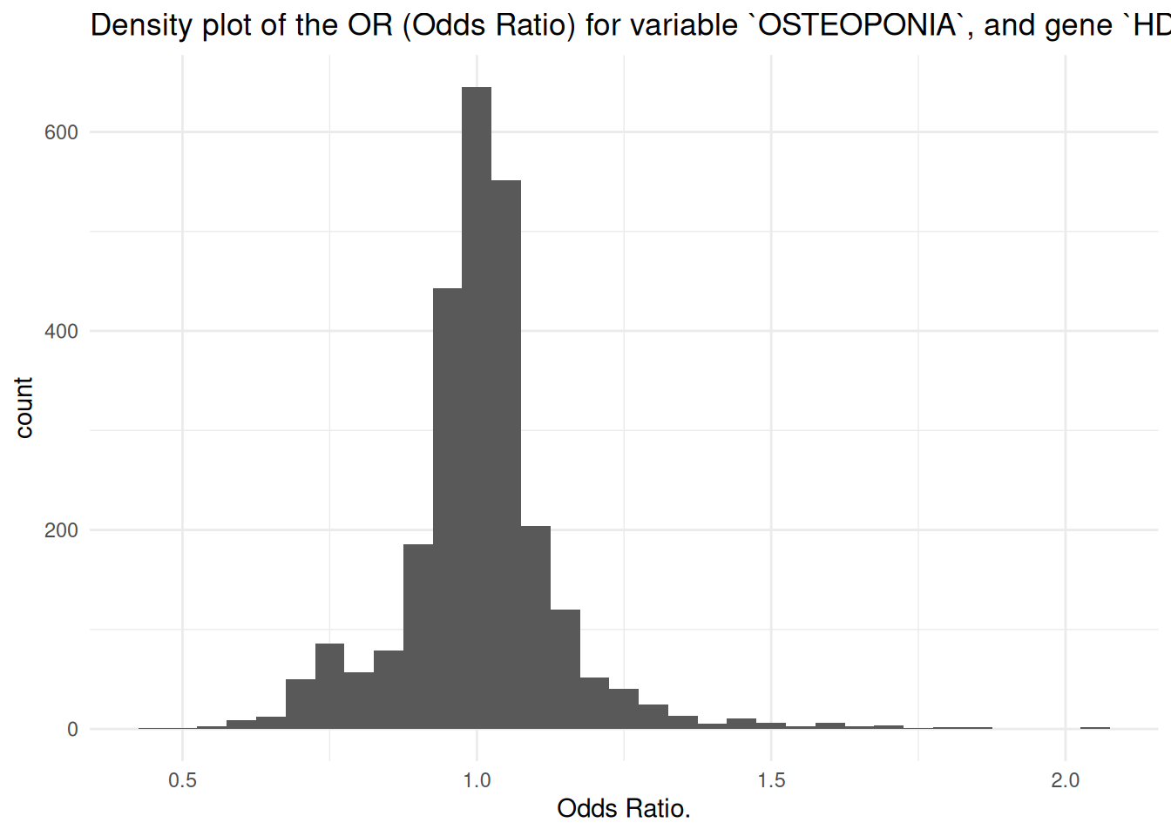
Preliminary results on HDAC-9: GWAS visualisations Example with OSTEOPONIA feature
Odds-ratio:
OR interpretation: Case over control
OR of 1: no impact of the SNP on the feature
OR below 1, for instance 0.5: the SNP decreases by 2 the risk of getting the disease
OR above 1, for instance 2: chances of getting the phenotype multiplied by 2
Moving from statistical significance to clinical relevance:
MCID (Minimal Clinical Important Difference)
Recommendation from Marie-Pier:
Either full GWAS
Or follow guidelines from (with a historically prior defined threshold): A current guide to candidate gene association studies

Slide 14
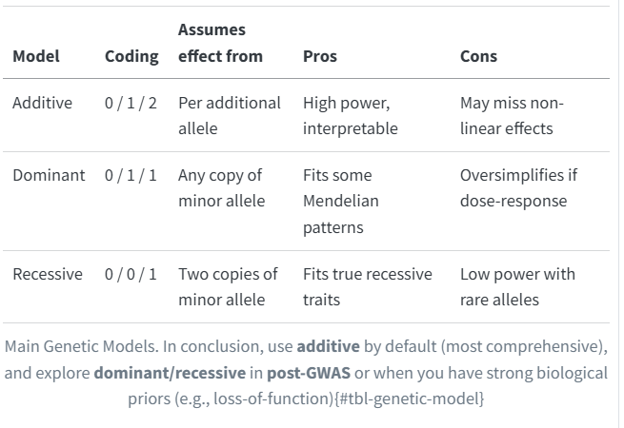
Pipeline: what’s next?
Power analyses run with GENPWR
Parameters to control:
Models generated and tested under H0
Choice of the genetic model (Additive, Dominant, Recessive, 2df=Dummy) + logistic or continuous
Case proportion
OR (2, 3 and 4)
MAF (alpha adjusted may depend on the frequency)
Alpha (rejecting H0):
Without adjustment
Gene specific
GWAS historical
Power (select rightfully H1): 0.8

Slide 15
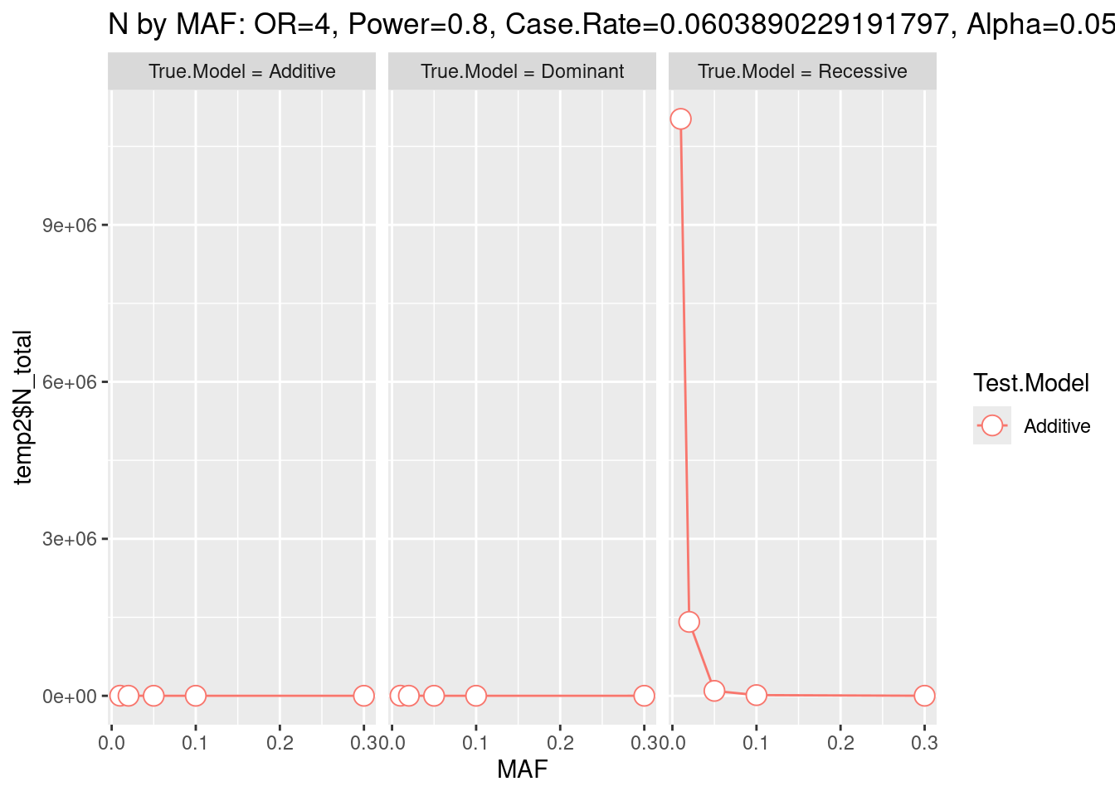
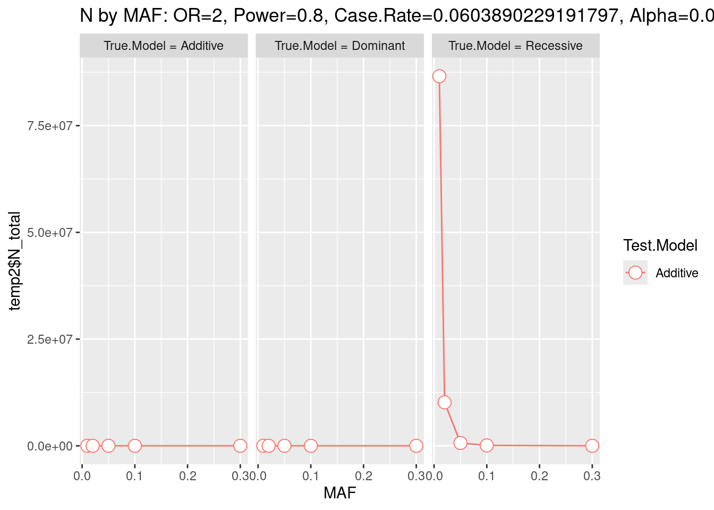
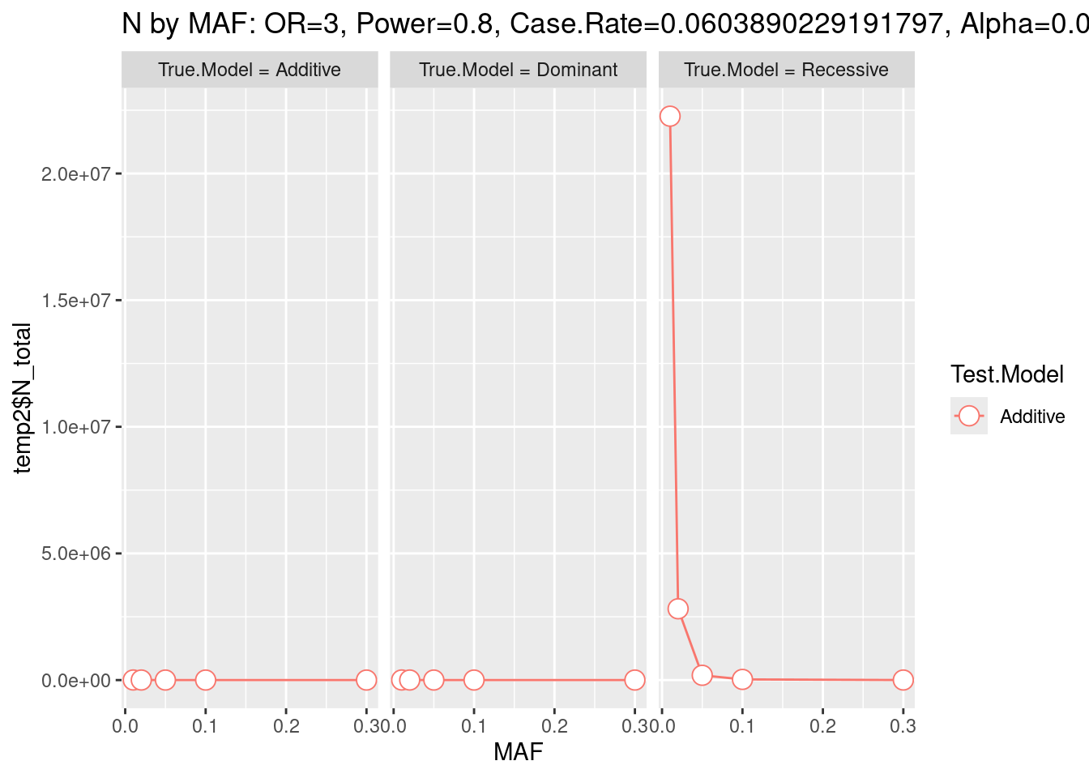
Sample size analysis: optimistic scenario
Most optimistic scenario (MAF: 0.3, OR: 4, Real:Recessive vs Tested:Additive) needs 157 samples.
Intermediate scenario (MAF: 0.05, OR: 3, Real:Additive vs Tested:Additive) needs 725 samples.
Finally, the worst scenario (MAF: 0.01, OR: 2, Real:Recessive vs Tested:Additive) needs 86,593,663 samples

Slide 16
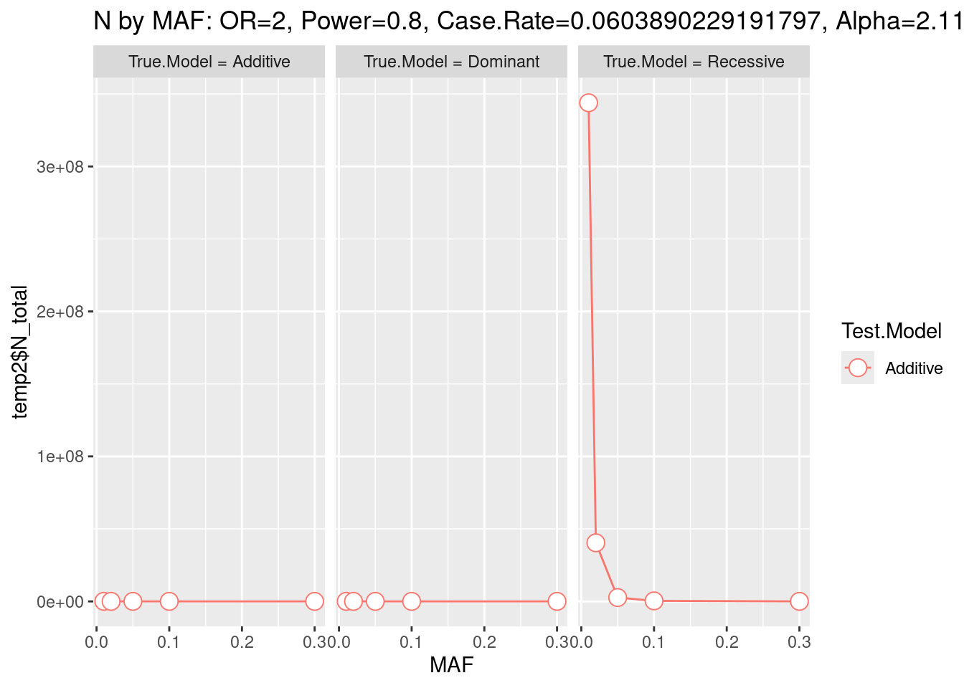
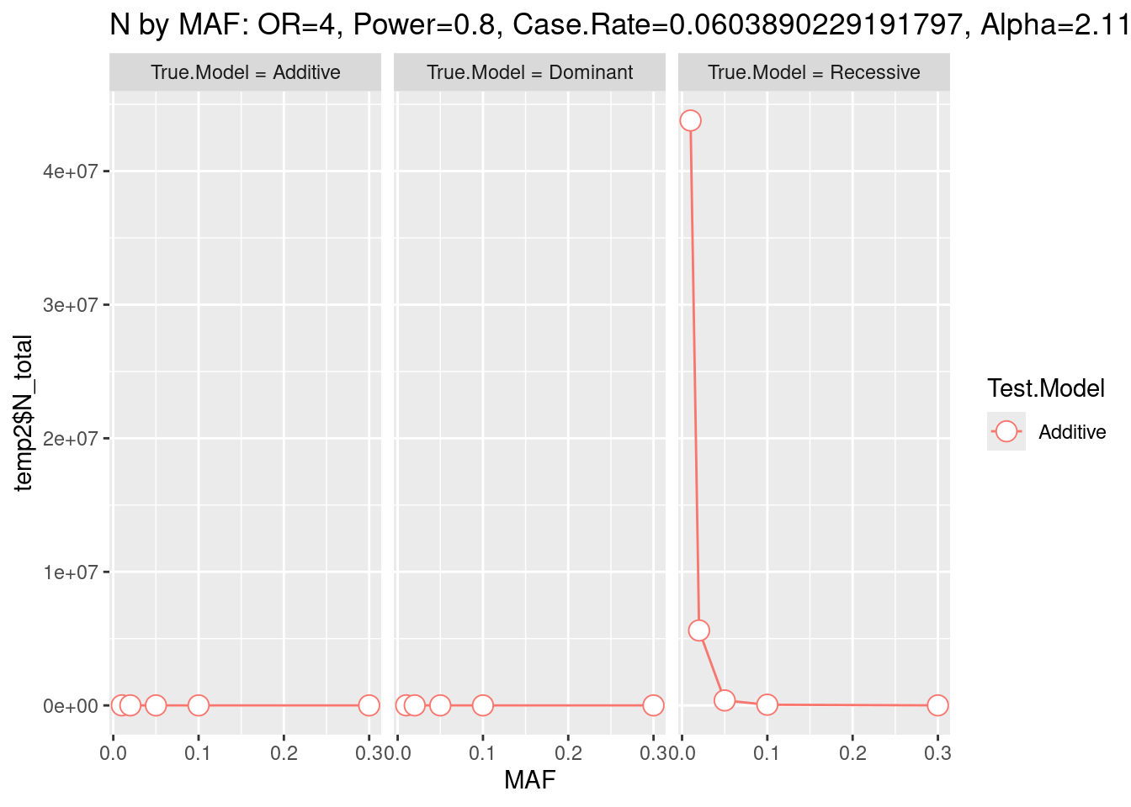
Sample size analysis: intermediate scenario, with gene-size
Most optimistic scenario (MAF: 0.3, OR: 4, Real:Recessive vs Tested:Additive) needs 622 samples.
Intermediate scenario (MAF: 0.05, OR: 3, Real:Additive vs Tested:Additive) needs 2877 samples.
Finally, the worst scenario (MAF: 0.01, OR: 2, Real:Recessive vs Tested:Additive) needs 343,931,663 samples.

Slide 17
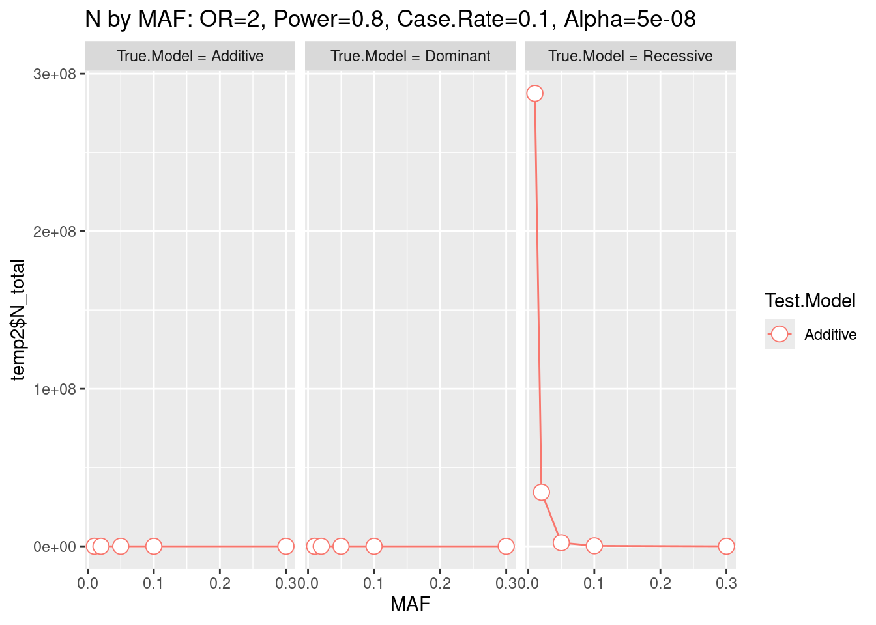
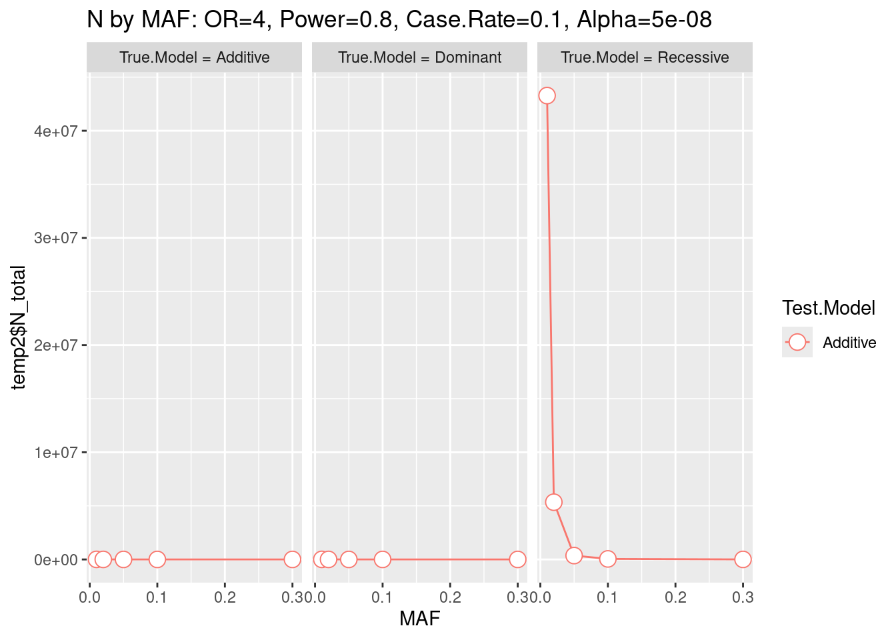
Pessimistic scenario (but actually the more realistic)
Most optimistic scenario (MAF: 0.3, OR: 4, Real:Recessive vs Tested:Additive) needs 517 samples.
Intermediate scenario (MAF: 0.05, OR: 3, Real:Additive vs Tested:Additive) needs 2,478 samples.
Finally, the worst scenario (MAF: 0.01, OR: 2, Real:Recessive vs Tested:Additive) needs 287,495,685 samples.

Slide 18
Limitations of GENPWR
Not FDA-approved + not updated anymore + no official package
Ugly sample-size plots + not flexible reporting
Not GWAS-intrinsic
Peculiar outputs: with Rare conditions, returned negative sample sizes + non-monotic increase of the number of samples required by decreasing the significance threshold
-> Literature gap, at least as a R package ☺

Slide 19
Statistical Perspectives
Focus sample size analysis on the most promising SNPs (OR of 2, p-val below 10^-4) -> what would be the number of samples to incorporate to the study to conclude to an efficient effect + Meta-Analysis (incorporate GWAS studies from abroad, noting the two specificities of the cohort)
High level of consanguinity + contamination by natives (from Simon and Julie Hussein studies)
Restriction to Caucasian phenotypes
Why Gene-candidate, rather than GWAS + regulatory regions? -> Data-driven selection of variants
Include other covariates, like sex?
Expand the study beyond SNPs on coding regions:
Structural Variants (SVs): large insertions, deletions, duplications, inversions, translocations, Copy Number Variations (CNVs), epigenetic regions
Explore regulatory regions, introns and UTRs with VariantAnnotation::locateVariants()
Incorporate familial pedigrees (PCA + known regional specificities)
Pair with expression = eQTL. (for expression Quantitative Trait Loci)
Polygenic scores (only we identified relevant SNPs first!!)

Slide 20
Computational perspectives
Migrate the project on ComputeCanada for full access to every stakeholder
If possible, limit resorting to CLI tools when R package alternatives, more comprehensive in terms of feature, are available OR
Full DSL Nextflow workflow, using modular, community-driven and official modules, such as:
Nf-GWAS
Multiqc
Vcftools and multivcfanalyzer
Native inclusion of bctools and plink2 CLIs
Gather all datasets to reproduce the analysis under the same R Project (till now, for the largest ones, only risky symbolic links)

